Slide 1
Welcome

Slide 2


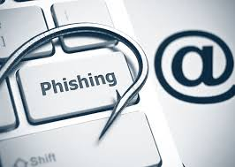
Dr. D.Y. Patil Pratishthan’s College of Engineering Salokhenagar, Kolhapur 2024-2025
A Presentation on
Detection of Phishing Emails Using Machine Learning
Submitted By :
Mr. Shantanu Ganesh Kamble (27)
Mr. Shivam Raghunath Kamble (28)
Mr. Gourang Narendra Lawana (32)
Mr. Vasant Suresh Lohar (33)
Mr. Digvijay Ramchandra Patil (50)
Guide – Prof. Suyog Vilas Tate-Patil

Slide 3
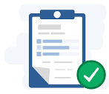
Contents :
Problem Statement
Introduction
Technique
Conclusion
Reference

Slide 4
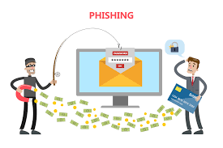
Introduction
Phishing emails are Fraud emails that trick people into giving away important information. This project is trying to stop these Fraud emails. We're going to find ways to spot these fake emails and stop them from reaching people's inboxes.
The “Detection of Phishing Emails Using Machine Learning" project aims to develop comprehensive strategies and technologies to detect and mitigate these threats. This project involves several key components:
User Awareness
Advanced Filtering Techniques
Incident Response Protocols
Regular Audits and Updates
Collaborative Efforts

Slide 5
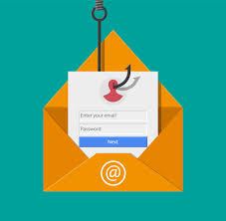
Problem Statement
Detection of Phishing Emails using
Machine Learning
Use machine learning to detect phishing Emails.
reduce the risk of falling victim to phishing attacks.
Enhanced user protection through real-time warnings.
The project addresses email phishing and malicious content detection.It focuses on identifying phishing attempts by analyzing email metadata and content, such as URLs, attachments, and keywords.

Slide 6
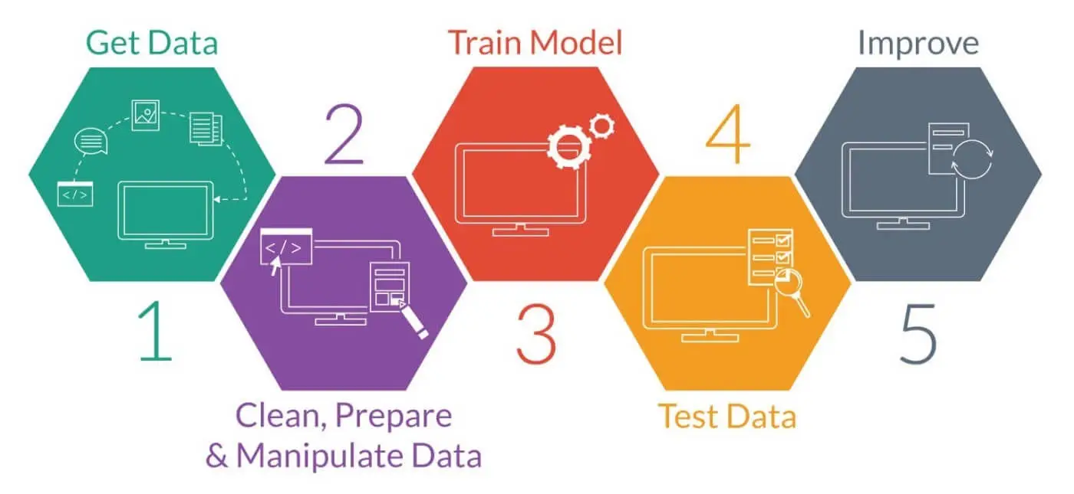
Proposed Phishing Detection System
The proposed phishing detection system offers a comprehensive approach to combating phishing attacks. By combining data collection, feature extraction, machine learning, and user awareness, the system can provide a valuable tool for organizations and individuals to protect themselves from the risks associated with phishing.
Data Collection and Preprocessing Gather a dataset of emails labeled as "phishing" or "legitimate.“
Feature Extraction Extract key features from emails, such as URLs, subject lines, and email content.
Machine Learning Module
Use the PHI-Net (MLPClassifier) algorithm, which builds multiple decision trees based on those features, to . . . train the model on the dataset.
Real-Time Updates and Threat
IntelligenceKeep the model updated with the latest phishing trends and incorporate new data for . retraining.
User Awareness and Evaluation
Enhance user awareness and measure system effectiveness.

Slide 7
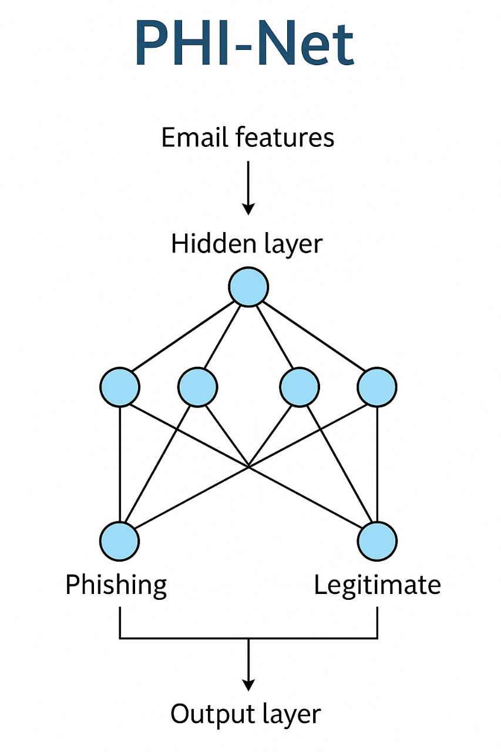
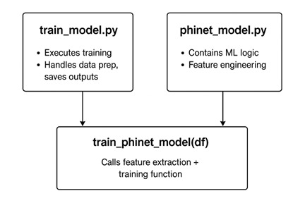
Technique
PHI-Net (MLPClassifier) is a versatile and powerful machine learning algorithm. Its ability to handle large datasets, reduce overfitting, and provide feature importance makes it a popular choice for various classification and regression tasks. By understanding its principles and tuning its hyperparameters, you can effectively apply PHI-Net (MLPClassifier) to your own data analysis problems.
Applications of PHI-Net (MLPClassifier)
Classification:
Spam filtering
Customer churn prediction
Image classification
Anomaly detection:
Identifying fraudulent transactions

Slide 8
1. Data Preprocessing:- The dataset contains columns for email bodies, URLs, attachments, and labels.- Features include email body length, presence of suspicious keywords, and domain analysis.
2. Model Training:- A custom PHI-Net model is used with a decision tree-based classifier.- Metrics are calculated to evaluate performance.
3. Deployment:- A Flask application serves as the interface for model predictions.

Slide 9
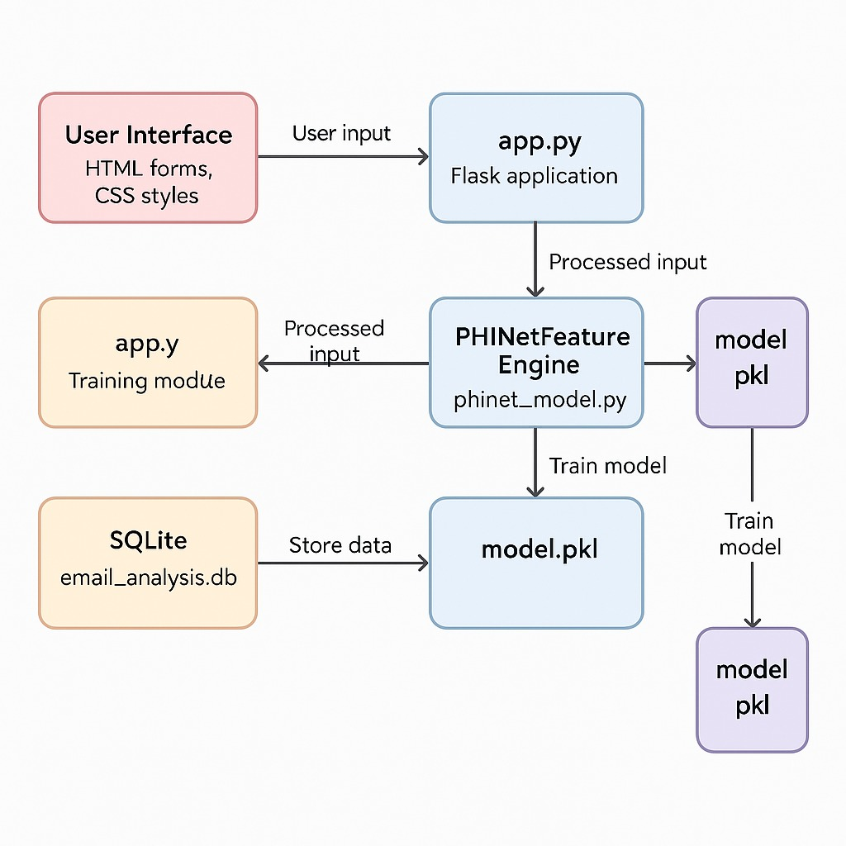
Architecture : Machine Learning Model for Phishing Emails Detection

Slide 10
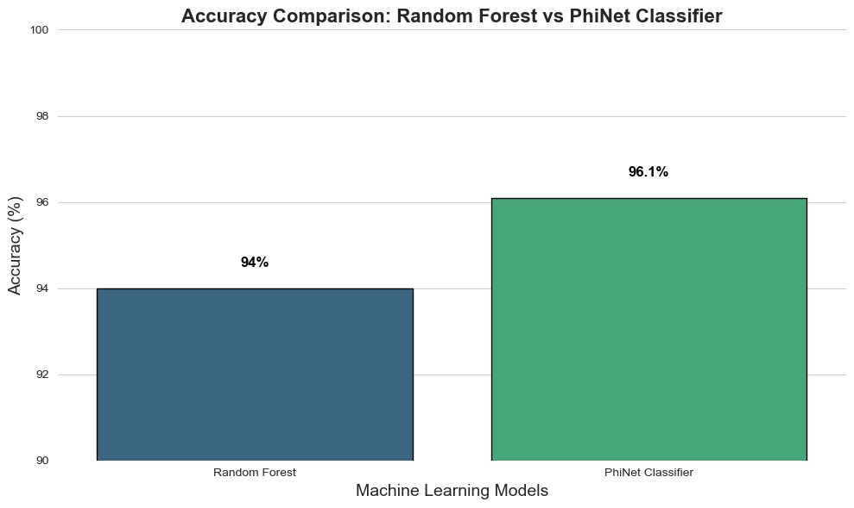

Slide 11
Future scope
Incorporating natural language processing (NLP) models like BERT for
Deeper content analysis Expanding the feature set to include time-based and behavioural patterns Adding email header analysis for better sender verification
Deploying the application using Docker and cloud hosting (e.g., Heroku, AWS)
Building an alert/notification system for flagged phishing attempts

Slide 12
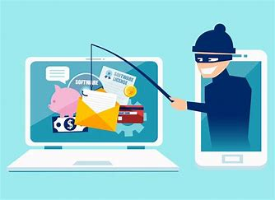
Conclusion
creating and using a Phishing detection System is a very important step to make our computers and online information safer in this changing world of technology. This project is designed to protect people and businesses from dangerous phishing attacks, which are becoming more common and tricky. By stopping these harmful emails, we can help keep our personal information and money safe.

Slide 13
THANK YOU

